Slide 1
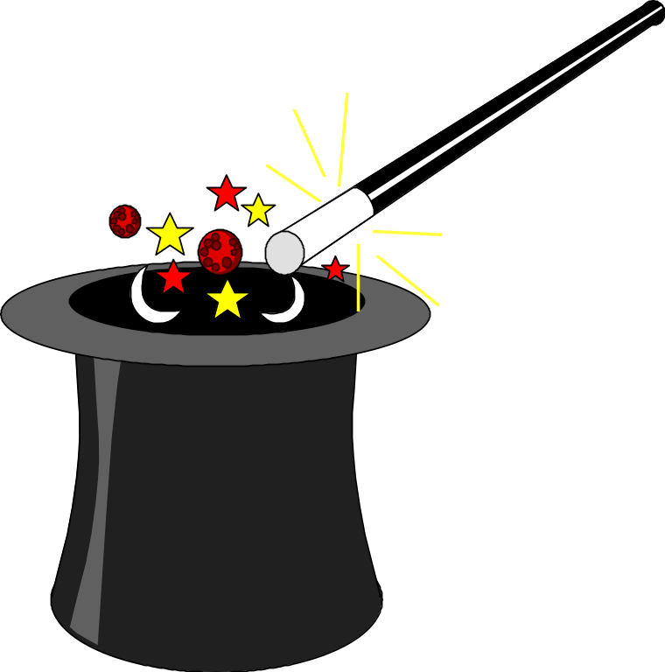
Advice from Real Magicians
Project Managers
Kathy Schwalbe, Ph.D., PMP
October 7, 2005
PDS 2005
schwalbe@augsburg.edu www.kathyschwalbe.com

Slide 2
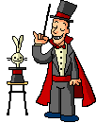
Presentation Background
Most of the information in this presentation is based on interviews my students have done in the past year or so
Thanks students and interviewees!
Note: I collected a lot more info AFTER this presentation was due to PMI-MN, so there’s a lot of new data. Access from www.kathyschwalbe.com under My Bio

Slide 3
Question #1: How did you get into project management?
Most worked in the organization and/or business area and slowly got into PM
Many tried out managing a small project and then got into PM if they did well and liked the role of PM
Some found it an unanticipated byproduct of their current job
A few actually planned it and studied PM as a discipline, either in college or on the job

Slide 4
Risk Assessment
Have a good process in place for finding, selecting, training, and mentoring project managers
Have a good process in place for managing projects period!
Provide a career path for project managers
Reward good performance and risk-taking

Slide 5
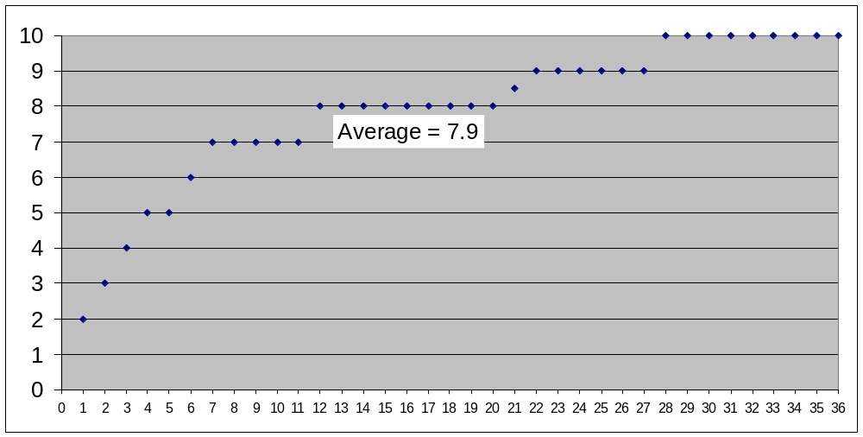
Question #2: If you had to rate the job of project manager on a scale of 1-10, with 10 being the highest, how would you rate it?*
* Results from Sep 2005 student interviews

Slide 6
Comments on High Ratings
To be frank, I would actually give it a 100. I just love every bit of it
10+ because being a PM allows you to take your own ideas and make them into a success
10 of course! I get to see the product of my labor
It is very gratifying to see the final product
What I enjoy most is the fact that I can make a difference
Several rated a 9 because they never give a 10

Slide 7
Comments on Low Ratings
Don’t like the stress
Hours are too long
Too many details
Hate the politics
Hard to work with some people
Depends on the project and senior management’s attitude
Miss the hands-on work (engineering)

Slide 8
Risk Assessment
Provide a good environment for PMs
People who are talented at managing projects and like to do so are more likely to succeed, as are their projects
Don’t hire the guy who said
“Don’t become a PM. It sucks. I have no time for anything. I have schedules and goals to meet.”

Slide 9
Question 3: Briefly explain the reason for your rating. What do you enjoy most and what do you like least about being a PM?
Enjoyed most:
  Challenge
  Variety
  Seeing end product
Enjoyed least:
  Stress
  Long hours
  Politics

Slide 10
Risk Assessment
Find out what your project managers like and dislike about their jobs
Develop strategies to minimize the dislikes and maximize the likes!
Ideas on maximizing challenge, variety, seeing end product?
Ideas on minimizing stress, long hours, politics?

Slide 11
Question 4: Did you have any training or special talents or experiences that qualified you to be a project manager? Are you certified or have you thought about becoming certified as a PMP?
Most had work experience in the organization
Most had good organization and communication skills
Few had formal training or PMP certification
Several said experience was much more important than certification, but it could help you when starting out

Slide 12
Risk Assessment
Hire for and develop talented PMs
Provide training and mentoring within the organization

Slide 13
Question 5: What do you feel is the most important thing you do as a project manager? On what task do you spend the most time each day?
Delivering results
Planning
Communicating, facilitating, talking to people
Team building - helping others realize their potential
Controlling – making sure things get done
Making decisions in a timely manner
Interfacing with the customer, developing relationships

Slide 14
Risk Assessment
Remember Covey’s Quadrant II activities: those that are important and not urgent – that’s where project managers should focus their efforts (planning, developing relationships, etc.)

Slide 15
Question 6: What are some of the positive and negative risks you’ve experienced on projects?
Negative risks:
  Physical harm (fire department PM)
  Weather (construction co. PM)
  Fines
  People quitting or moving on
  Change of priorities
  Poor communications
  Poor estimates
  Trusting team members to deliver and they don’t
  People who are hard to work with

Slide 16
Example of a Negative Risk
The PM in charge of having a famous comedian do stand up comedy at Mystic Lake Casino had the following problem:
He refused to go on stage until he had a hamburger from Wendy’s. The nearest Wendy’s was 30 minutes away, and the comedian went on stage an hour late
The audience was not happy!

Slide 17
Positive Risks
Note: Some PMs said risks are only negative
The more challenging the project, the more you learn
Personal satisfaction
Recognition from upper management
Confidence
Sense of accomplishment/meaning

Slide 18
Example of a Positive Risk
A PM with a construction firm said every job is different and presents new and unique challenges
“I get to be a part of constructing things that will be used by many people and be around for a long time, which is something I am proud of.”

Slide 19
Risk Assessment
Do project managers in your organization discuss negative and positive risks?
Do they share advice and lessons learned?

Slide 20
Question 7: What are some of the tools, software or otherwise, that you use, and what is your opinion of those tools?
Several mentioned PM SW, like Microsoft Project, Primavera, etc.
More mentioned other Office SW (Excel, Word, PowerPoint)
Many mentioned email and cell phones
Some mentioned non-SW tools, like a WBS, Gantt chart, etc.
Most said tools were adequate

Slide 21
Risk Assessment
People get projects done, not the latest software or other tool
Let people use their brains and experiences
A fool with a tool is still just a fool; make sure tools are helpful

Slide 22
Question 8: What are some steps a project manager can take to improve the effectiveness and efficiency of a team? How does a new project manager gain the respect and loyalty of team members?
Define goals and objectives clearly
Exploit people’s talents
Praise publicly and correct privately
Communicate, communicate communicate

Slide 23
Continued (teams)
Lead by example
Apply the golden rule at all times
When in doubt, be honest
Have team involved in planning
Be organized and avoid negativity
Don’t try to be a know-it-all
Go into the trenches to help team members when needed to show that no job is less important than another

Slide 24
Continued (teams)
Shoot the underperformers!
Get respect by being right
Raise morale and get people excited about the project
Be calm and the voice of reason
Always be prepared, always be the hardest working, and always listen,
Manage the details without micromanaging
Be fair and have integrity

Slide 25
Risk Assessment
Do you follow the advice (most of it) given?
Do you spend time on team development?
Do you define team goals clearly and reward team performance?

Slide 26
Question 9: What suggestions do you have for working with sponsors and senior managers?
Listen, and learn from them
Meet face to face
Never hide a problem
Don’t give in to politics. Back up decisions with facts
Avoid cockiness. Be willing to follow; not just lead
You cannot over-communicate with them
Have mentors to help you
Build a good rapport and great respect with them. Then, politely ask them to stay out of the way for you to get your job done

Slide 27
Risk Assessment
The most important factor in project success is executive support
Make sure you have it!
Make sure your project managers can speak to executives, and vise versa

Slide 28
Question 10: Do you have any suggestions for future project managers, such as any specific preparations they should make, skills they should learn, etc?
Get your hands dirty. Get experience
There is no training for common sense
Use facts whenever possible and necessary
Never over promise unless you have unlimited budget

Slide 29
Suggestions for PMs (continued)
Build good relationships
Understand the business
Be pen-minded, flexible, improvise
Learn, apply, assess, correct, share, and then do it over again and again
Take one problem at a time or you will get too stressed out and burn out
Be organized
Make sure you want to be a PM. Hard to get back into a technical job

Slide 30
Suggestions for PMs (continued)
Maintain enough authority to steer the project when necessary, but let the team members do the driving when you are not required to
Be broad-minded and develop a lot of skills
Be sure to work hard, but also work smart
Be patient and don’t give up
Learn from other PMs

Slide 31
Risk Assessment
A smart person learns from his own mistakes; a wise person learns from those of others

Slide 32
Final Thought: Take Time to Enjoy Life!

